Slide 1
Suggestions for an NTA Satellite, an SNA Point of View
By Dr. Jan W. van Tongeren ,
International Consultant on SNA and Macro Accounting for Policy Analysis,
Delft, Netherlands, email: jwvtongeren@gmail.com

Slide 2
Themes dealt with
I. Concepts of SNA analysis
II. Concepts of NTA analysis
III. Review of NTA concepts
IV. NTA compilation

Slide 3
I. SNA analysis

Slide 4
2010 Netherlands SNA Data

Slide 5
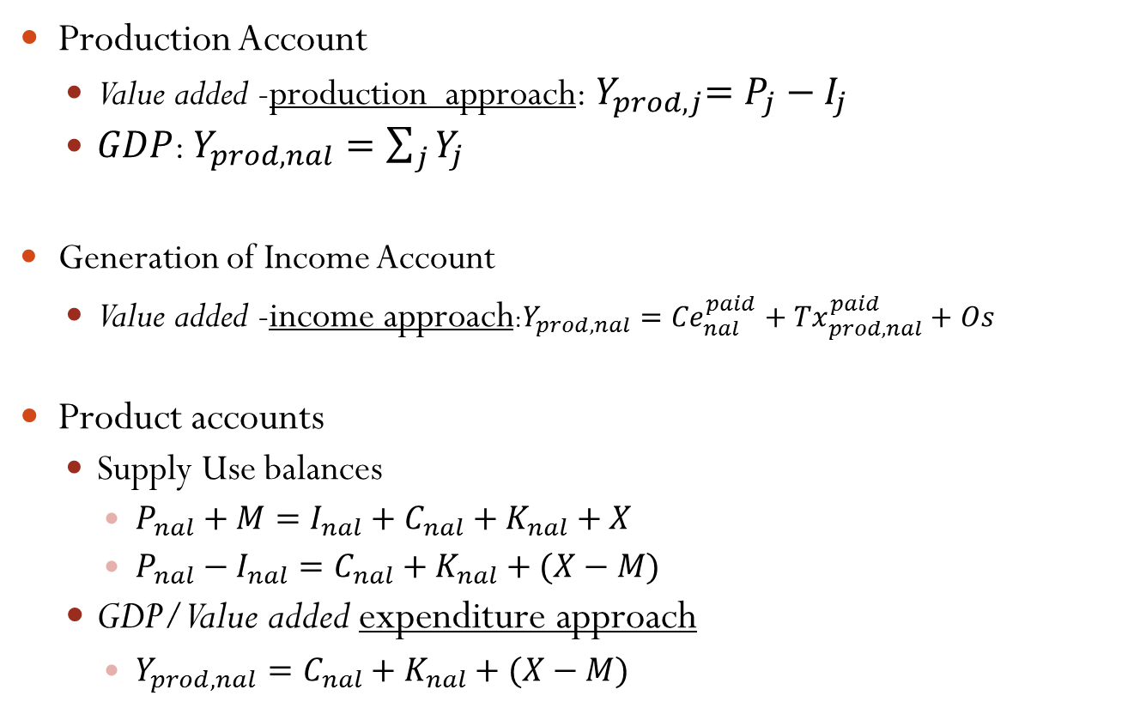
Policy analyses supported by SNA accounts and concepts, SUT
Production Account
Value added -production approach:${ Y}_{prod,j}=P_{j}−I_{j}$
$GDP$: $Y_{prod,nal}=\sum_{j}{Y_{j}}$
Generation of Income Account
Value added -income approach:$Y_{prod,nal}={Ce}_{nal}^{paid}+{Tx}_{prod, nal}^{paid}+Os$
Product accounts
Supply Use balances
$P_{nal}+M=I_{nal}+C_{nal}+K_{nal}+X$
$P_{nal}−I_{nal}=C_{nal}+K_{nal}+(X−M)$
GDP/Value added expenditure approach
$Y_{prod,nal}=C_{nal}+K_{nal}+(X−M)$

Slide 6
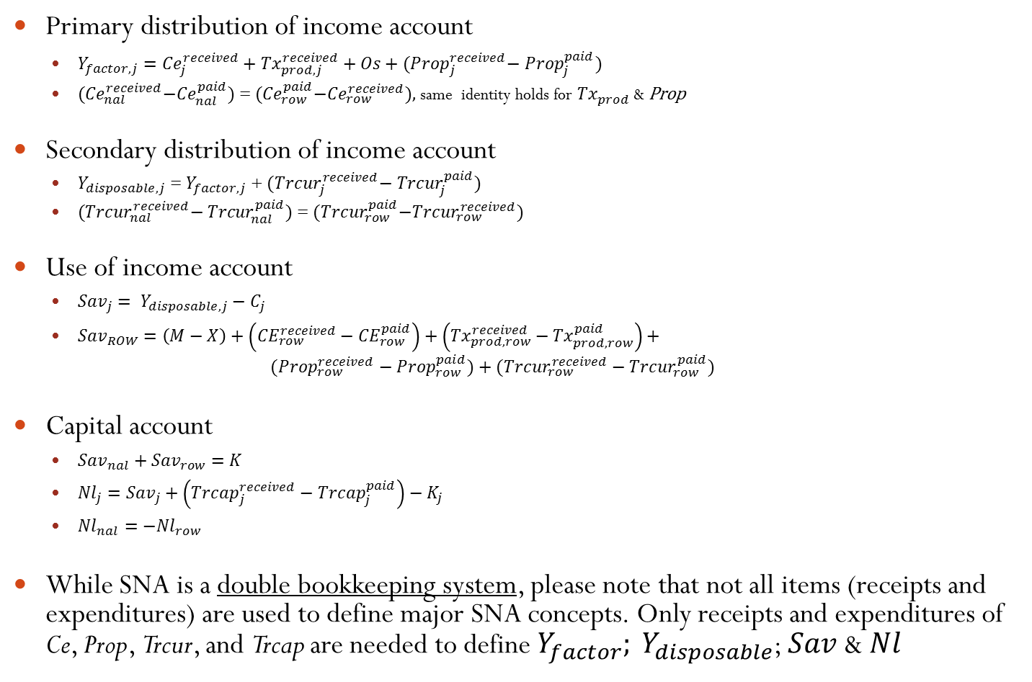
Policy analyses supported by SNA accounts and concepts, IEA
Primary distribution of income account
$Y_{factor,j}={Ce}_{j}^{received}+{Tx}_{prod,j}^{received}+Os+{(Prop}_{j}^{received}−{ Prop}_{j}^{paid})$
${(Ce}_{nal}^{received}−{Ce}_{nal}^{paid})$ = ${(Ce}_{row}^{paid}−{Ce}_{row}^{received}),$same identity holds for ${Tx}_{prod}^{}$ & Prop
Secondary distribution of income account
$Y_{disposable,j}$ = $Y_{factor,j}$ + ${(Trcur}_{j}^{received}−{ Trcur}_{j}^{paid})$
${(Trcur}_{nal}^{received}− {Trcur}_{nal}^{paid})$ = ${(Trcur}_{row}^{paid}−{Trcur}_{row}^{received})$
Use of income account
${Sav}_{j}= Y_{disposable,j}−C_{j}$
${Sav}_{ROW}=\left(M−X\right)+\left({CE}_{row}^{received}−{CE}_{row}^{paid}\right)+\left({Tx}_{prod,row}^{received}−{Tx}_{prod,row}^{paid}\right)+$
$$({Prop}_{row}^{received}−{Prop}_{row}^{paid})+({Trcur}_{row}^{received}−{Trcur}_{row}^{paid})$$
Capital account
${Sav}_{nal}+{Sav}_{row}=K$
${Nl}_{j}={Sav}_{j}+\left({Trcap}_{j}^{received}−{Trcap}_{j}^{paid}\right)−K_{j}$
${Nl}_{nal}=−{Nl}_{row}$
While SNA is a double bookkeeping system, please note that not all items (receipts and expenditures) are used to define major SNA concepts. Only receipts and expenditures of Ce, Prop, Trcur, and Trcap are needed to define $Y_{factor}; Y_{disposable}$; $Sav$ & $Nl$

Slide 7
II. NTA analysis

Slide 8
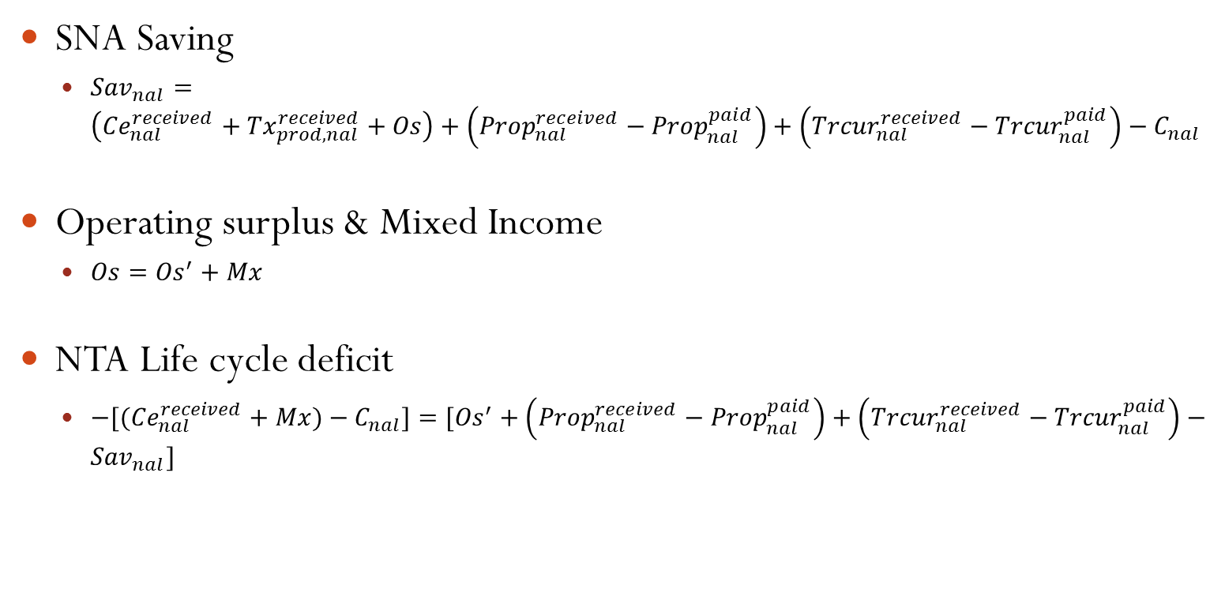
Analysis supported by NTA Accounts and Concepts
SNA Saving
${Sav}_{nal}=\left({Ce}_{nal}^{received}+{Tx}_{prod,nal}^{received}+Os\right)+\left({Prop}_{nal}^{received}−{Prop}_{nal}^{paid}\right)+\left({Trcur}_{nal}^{received}−{Trcur}_{nal}^{paid}\right)−C_{nal}$
Operating surplus & Mixed Income
$Os={Os}^{′}+Mx$
NTA Life cycle deficit
${−[(Ce}_{nal}^{received}+Mx)−C_{nal}]=[{Os}^{′}+\left({Prop}_{nal}^{received}−{Prop}_{nal}^{paid}\right)+\left({Trcur}_{nal}^{received}−{Trcur}_{nal}^{paid}\right)−{Sav}_{nal}]$

Slide 9
NTA Satellite with 2010 Netherlands data

Slide 10
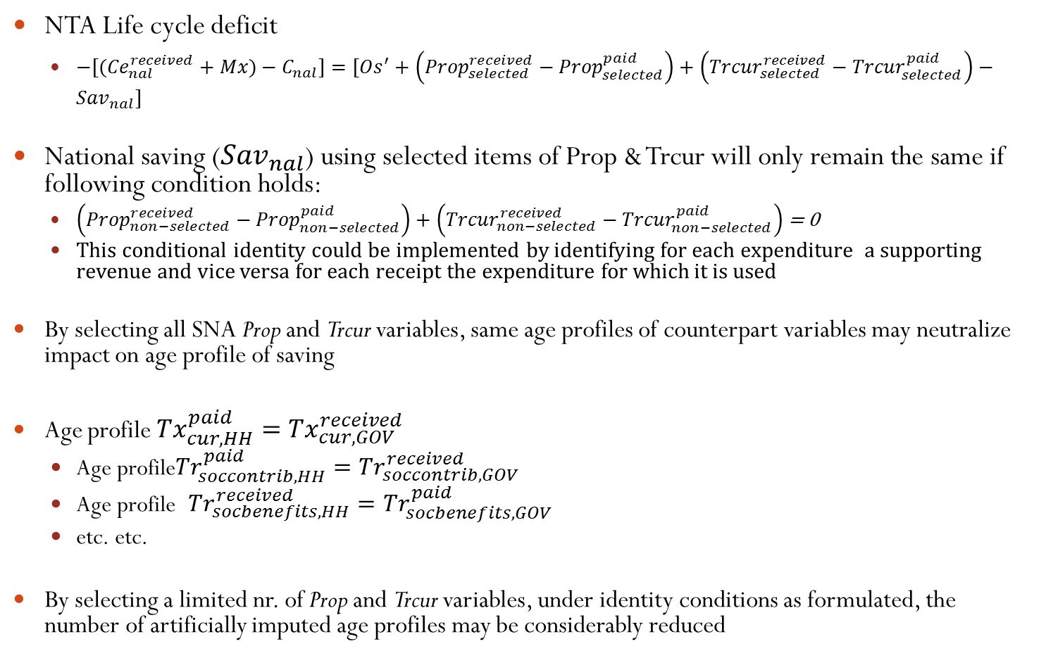
Selection SNA Variables (received and paid) for Use in NTA, NTA balances, general principles
NTA Life cycle deficit
${−[(Ce}_{nal}^{received}+Mx)−C_{nal}]=[{Os}^{′}+\left({Prop}_{selected}^{received}−{Prop}_{selected}^{paid}\right)+\left({Trcur}_{selected}^{received}−{Trcur}_{selected}^{paid}\right)−{Sav}_{nal}]$
National saving (${Sav}_{nal}$) using selected items of Prop & Trcur will only remain the same if following condition holds:
$\left({Prop}_{non−selected}^{received}−{Prop}_{non−selected}^{paid}\right)+\left({Trcur}_{non−selected}^{received}−{Trcur}_{non−selected}^{paid}\right)$ = 0
This conditional identity could be implemented by identifying for each expenditure a supporting revenue and vice versa for each receipt the expenditure for which it is used
By selecting all SNA Prop and Trcur variables, same age profiles of counterpart variables may neutralize impact on age profile of saving
Age profile ${Tx}_{cur,HH}^{paid}={Tx}_{cur,GOV}^{received}$
Age profile${Tr}_{soccontrib,HH}^{paid}={Tr}_{soccontrib,GOV}^{received}$
Age profile ${Tr}_{socbenefits,HH}^{received}={Tr}_{socbenefits,GOV}^{paid}$
etc. etc.
By selecting a limited nr. of Prop and Trcur variables, under identity conditions as formulated, the number of artificially imputed age profiles may be considerably reduced

Slide 11
(Tentative) Selection SNA Variables for Use in NTA, practical implementation with 2010 Netherlands data
Included: All items in HH sector
Included: All items of GOV and NPI sector (related to financing GOV and NPI consumption)
However, Excluded: All counterpart of items in HH, NPI and GOV sector
Excluded: All items of NFC and FC sectors that have counterparts in NFC and FC sectors
In the selection a decision needs to be taken whether revenue or expenditure items should be selected

Slide 12
III. Review of NTA concepts

Slide 13
Social Transfers in kind should not be included in NTA

Slide 14
Mixed income should be imputed for HH durables, no capital component of mixed income of non-market output (?)

Slide 15
Production taxes and subsidies may not be deducted from HH final consumption

Slide 16
A distinction should be made between pension premiums and benefits of funded and unfunded schemes

Slide 17
A distinction should be made between labour income and remittances to/from abroad

Slide 18
Current transfers versus Capital transfers, criteria
Capital transfers only occur if an ASSET is transferred
Concept of asset may be changed between SNA and satellite accounts (e.g. HH durables, human capital and expenditures on education and health, R&D)
Capital transfers may be in CASH and IN-KIND
Capital transfers IN-KIND may concern TANGIBLE, INTANGIBLE AND FINANCIAL assets
Capital transfers if one of the parties considers the transfer as a capital transfer (e.gh. Development aid based on current GOV budget)
For total economy K=Snal + Srow; for sectors K=S + TrCap + Lfin

Slide 19
Current transfers versus Capital transfers, examples
Transfer of house between parents and children (in-kind)
Transfer of funds between parents and children under condition that they purchase a house (cash)
Reimbursement by insurance companies for damage to buildings, equipment, infrastructure, caused by fire and adverse weather conditions (cash)
Transfer of defense and other equipment between GOV’s (in-kind)
Funds provided by GOV’s to GOV’s for building roads and other infrastructure (cash)
Transfers between parents and children for purposes of education provided human capital is recognized as asset in satellite accounts
Cancellation of debt between GOV’s and between parents and children
Large donations by individuals and enterprises to NPI’s (universities, research centers, etc.), presumably for purposes of investment
Bequests to children at death of parent (not explicitly mentioned in SNA)

Slide 20
IV. NTA compilation

Slide 21
NTA Compilation, NTA Manual
Adjust micro data by age groups based on HH related surveys to Macro (SNA) Totals

Slide 22
NTA Compilation, Conventional SNA compilation
Available data are incomplete; in annual compilation basic data cover approximately 50% of SNA variables
SNA structures of benchmark compilation (e.g. i-o coefficients) are used to complete needed information to estimate variables for which no basic data are available
SNA identities (e.g. supply-use identities, IEA distribution of receipts and expenditures) are used to arrive at consistent estimates
Including new micro HH data by ages implies that SNA compilation would need to be revised; estimates of Macro Totals would be changed if this information had been available at the time of the SNA compilation

Slide 23
NTA Compilation, Bayesian Compilation in SNA and Satellite Frameworks
Formalization of Bayesian estimation approach manually used in conventional national accounts compilation
Bayesian estimation approach uses four inputs:
Basic data of selected variables: age structure micro data, SNA macro estimates
Ratios: age structure composition of micro HH data, SNA coefficients: i-o coefficients, tax ratios, structure of composition of HH disposable income
SNA identities, identities between Macro-totals and sum of micro HH data
Prior reliabilities (standard deviations) of basic data on variables and ratios
Results of Bayesian estimation:
Posterior (adjusted) Bayesian estimates of all variables and ratios that are consistent,
Posterior standard deviations of all variables and ratios

